Slide 1
Building a platinum-resistant GPS map
Harismendy Lab meeting: Nov. 27, 2017
Fall 2017 Rotation project under Prof. Harismendy
BISB student Daniela Nachmanson

Slide 2
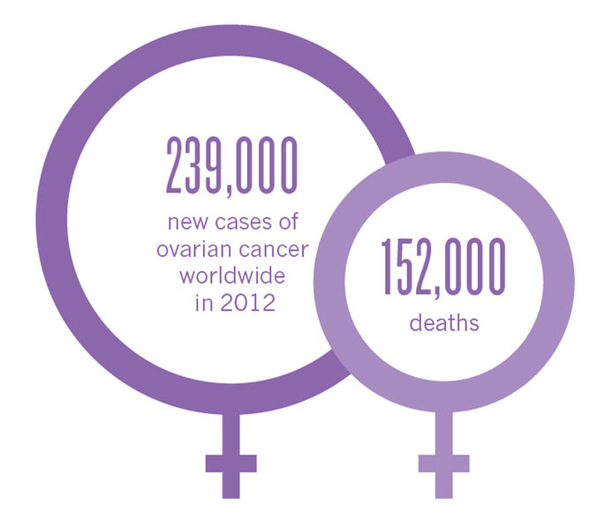
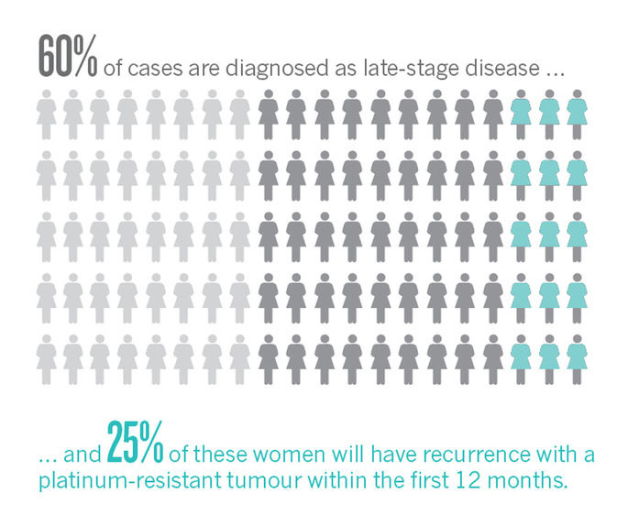
Platinum-based drugs are a primary therapy for many cancer patients but resistance is common
Especially in ovarian cancer
Holmes, 2015

Slide 3
Insert slide on gene expression heterogeneity here before map, or have map even later.

Slide 4
Insert slide about the CCLE data

Slide 5
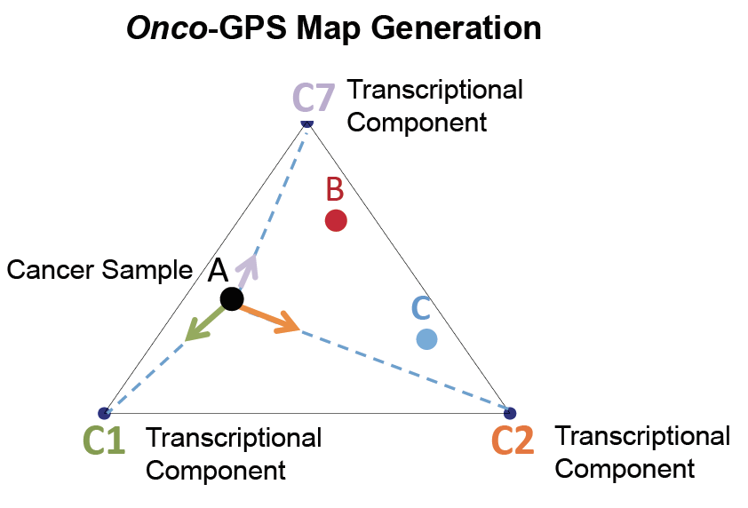
Project goal: Build platinum resistance GPS map - PlatiRes using a platinum-derived gene list
Kim J et al.
Notes:
Do not go into this yet, talk about the heterogeneity of gene expression data.

Slide 6
Overview
Identify genes correlated with platinum resistant phenotype
Using these genes, find the components (metagenes), using nonnegative matrix factorization (NMF)
Create Plati-Res GPS map

Slide 7
1) Identify genes correlated with platinum resistant phenotype
Differential gene expression analysis using publically available datasets
Qualifying Studies:
Ovarian cancer cell lines with acquired resistance with platinum-based drug (cisplatin, carboplatin, and oxaliplatin, etc..)
Must have both plati-resistant AND sensitive gene expression data

Slide 8
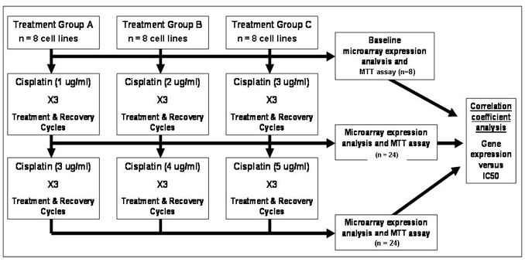
Marchion et al study:
n_resistant = 52 n_sensitive = 6
SI Fig1 Marchion D et al.
Notes:
‘This was not very smooth either, find better way to blend Olivier’s and marchion gene list information’

Slide 9
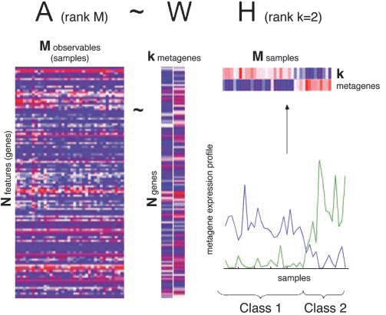
Final gene list Marchion GE +
Harismendy Bulk RNA Seq: 3443 genes
3443 genes

Slide 10
2) Apply NMF on CCLE
Now using these 3443 genes which are associated with the phenotype:
Take 750 expression profiles from the Cancer Cell Line Encyclopedia (CCLE) and apply data dimensionality reduction method, NMF (non-negative matrix factorization).
Brunet J et al.

Slide 11
NMF algorithm
Input: positive matrix A of size N X M, desired rank k
Output: two nonnegative matrices W X k and H X k where A ~ WH
+
k = 2

Slide 12
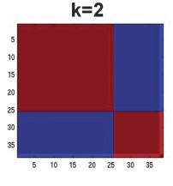
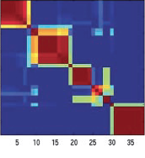
Which k to choose?
Use cophenetic correlation
C_{i,j} = 0 (samples not in same cluster)
C_{i,j} = 1 (samples in same cluster)
C
C
C
C
k=2
...
sample
sample
sample
sample
sample
sample
sample
sample
C
C
C
C
...
k=5
sample
sample
sample
sample
sample
sample
sample
sample

Slide 13
Which k to choose?
Use cophenetic correlation
C_{i,j} = 0 (samples not in same cluster)
C_{i,j} = 1 (samples in same cluster)
C
Dispersion of matrix C:
sample
k=2
𝝆_{k}(C)
Pearson correlation of two distance matrices
Distance b/w samples induced by the consensus matrix
Distance b/w samples induced by the linkage used in the reordering of C
𝝆_{k} = 1 Perfect consensus matrix
𝝆_{k} < 1 Less-than perfect consensus matrix
sample
C
k=5
sample
sample

Slide 14
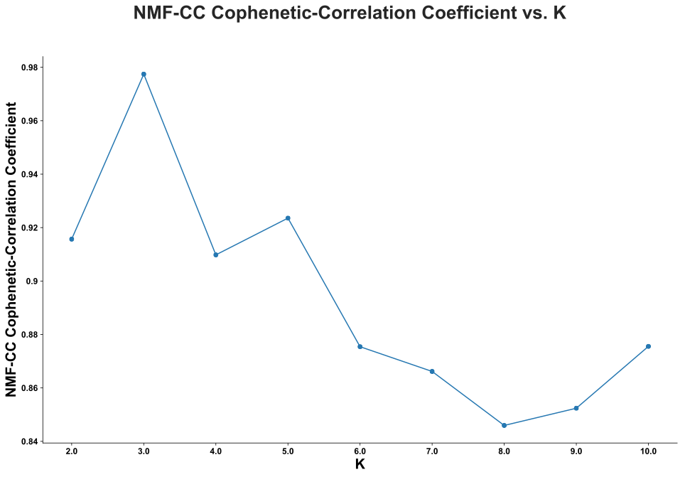
Tried k components = 2 -> 10
Choosing k=7

Slide 15
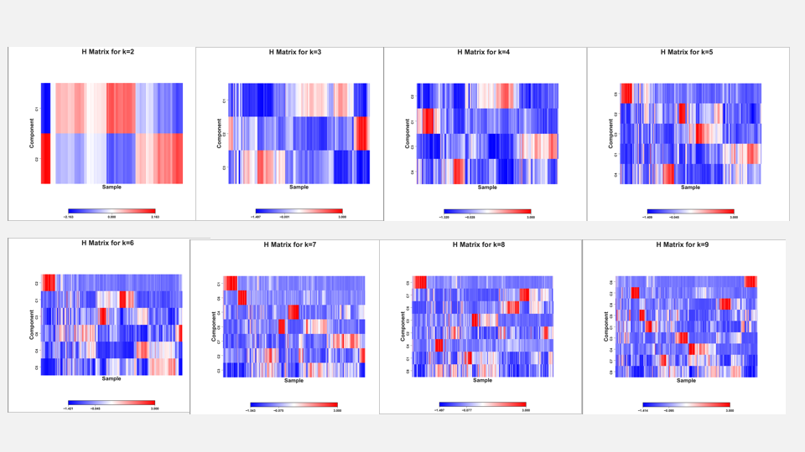

Slide 16
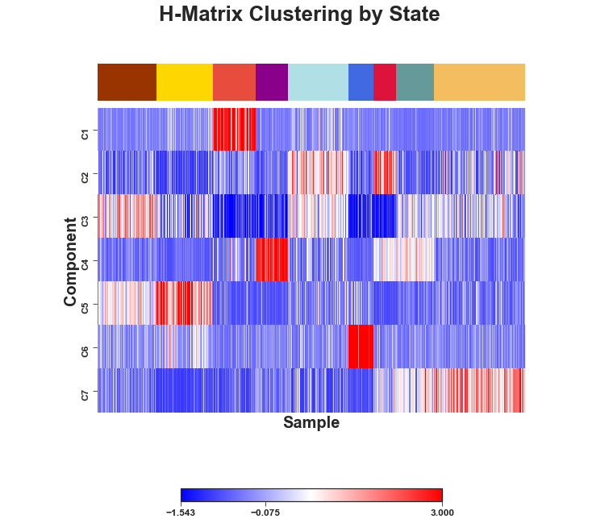
k=9

Slide 17
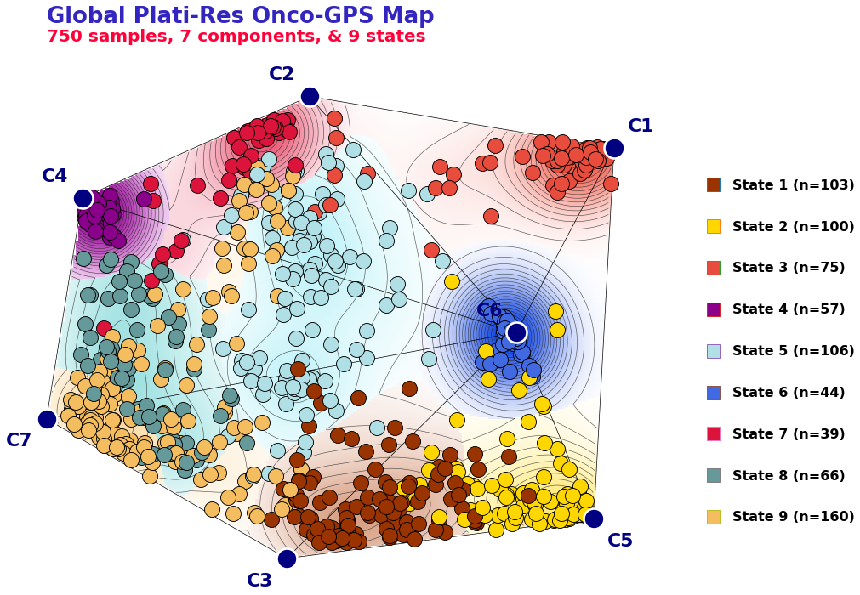
3) Create Plati-Res GPS Map
Using these components, cells will be visually represented on a 2-D map, analogous to an Onco-GPS map. This map clusters cells together based on their components, which will then be used to define molecular states for the cells.

Slide 18
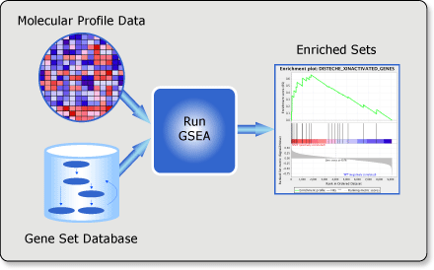
Annotating the components
Performed pre-ranked ssGSEA analysis on each of the components against both the Hallmark gene, Reactome and oncogenic gene sets obtained from MSig Database

Slide 19
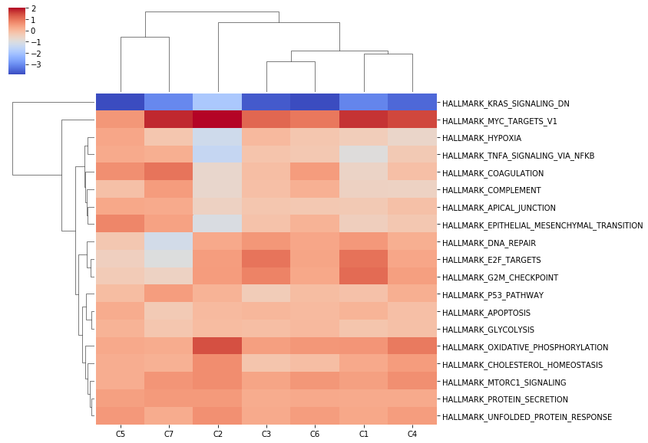
GSEA with Hallmark

Slide 20
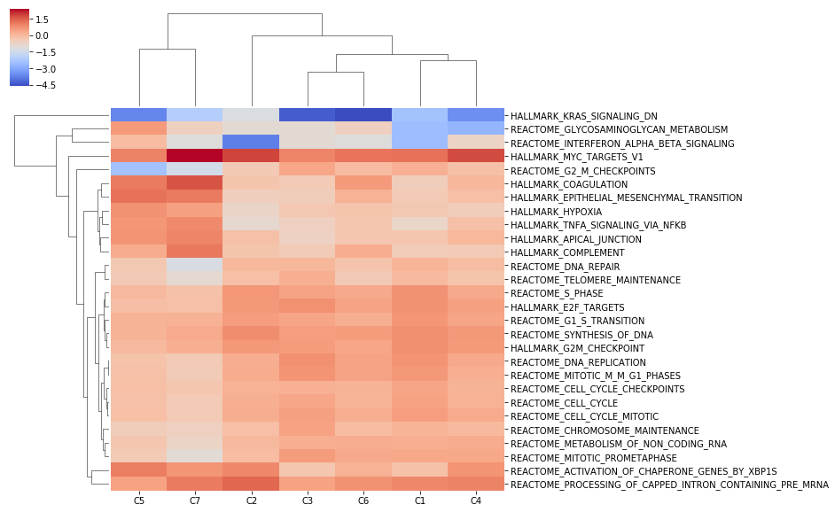
GSEA with Reactome & Hallmark

Slide 21
 | C1 | C2 | C3 | C4 | C5 | C6 | C7
High enrichment scores: | MYC E2F G2M | MYC, Oxid. Phosphorylation, E2F, G2M, Reactome processing of capped intron containing pre mrna | MYC E2F G2M, DNA Repair | MYC, Oxidative phosphorylation, | EMT Activation of chaperone genes by XBP1S | MYC Coagulation Complement Oxidative Phos Unfolded protein response | MYC Coagulation TNFA Complement Apical EMT P53 pathway Processing of capped intro containing mRNA
Annotation | MYC/ Cell cycle | MYC/ Oxid. Phos. | Cell Cycle | MYC/ Oxid.Phos. | EMT | Coagulation/ Complement/ Oxid.Phos. | Coagulation/ Complement/ EMT/P53 pathway

Slide 22
MYC/
Oxid. Phos.
MYC/ Oxid.Phos.
MYC/
Cell cycle
Coagulation/ Complement/ Oxid.Phos.
Coagulation/ Complement/ EMT/
P53 pathway
EMT
Cell Cycle

Slide 23
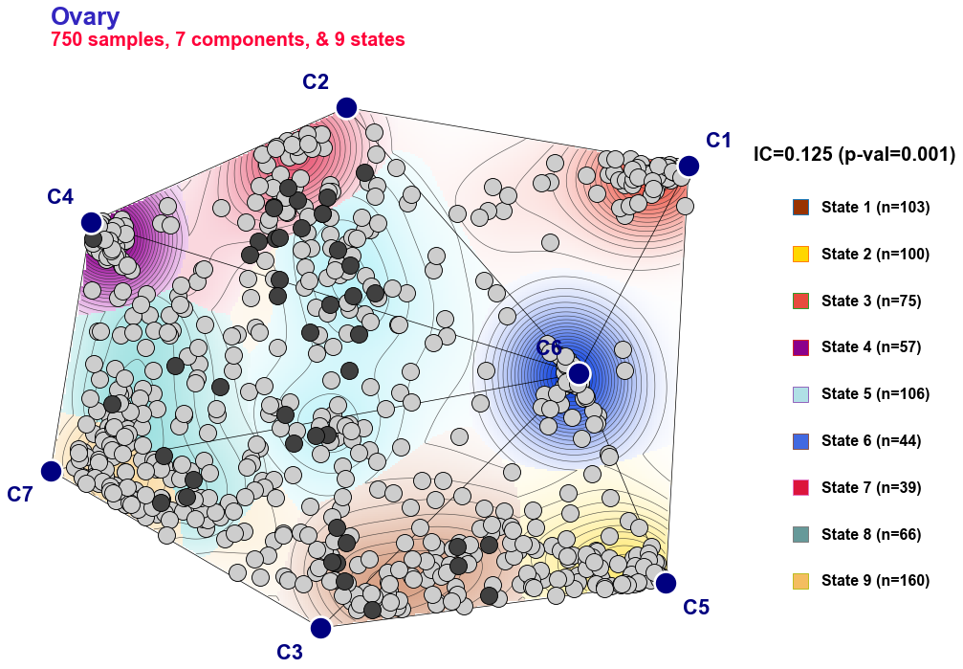
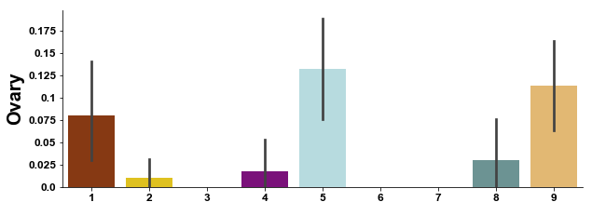
MYC/
Oxid. Phos.
MYC/ Oxid.Phos.
MYC/
Cell cycle
Coagulation/ Complement/ Oxid.Phos.
Coagulation/ Complement/ EMT/
P53 pathway
EMT
Cell Cycle

Slide 24
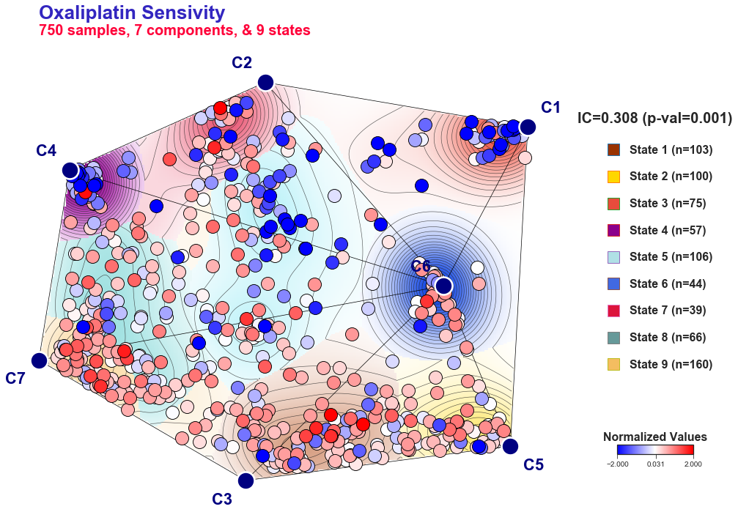
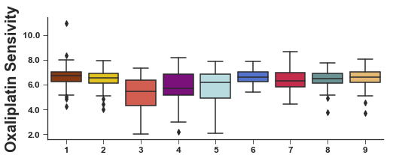
MYC/
Oxid. Phos.
MYC/ Oxid.Phos.
MYC/
Cell cycle
Coagulation/ Complement/ Oxid.Phos.
Coagulation/ Complement/ EMT/
P53 pathway
EMT
Cell Cycle

Slide 25
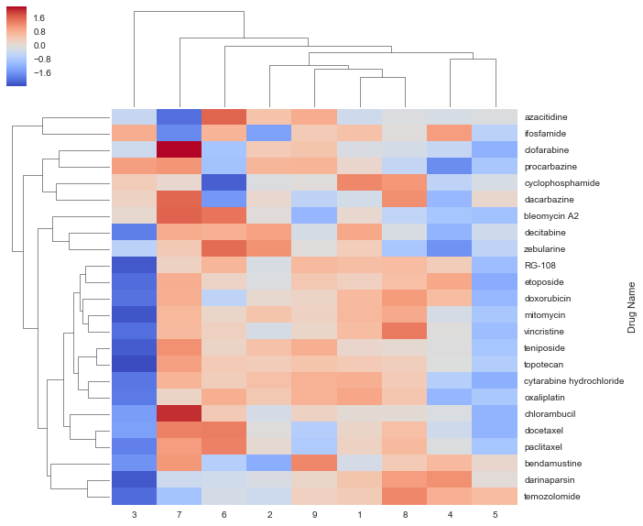
Drug Resistance by State
(mean IC50 value in that state)

Slide 26
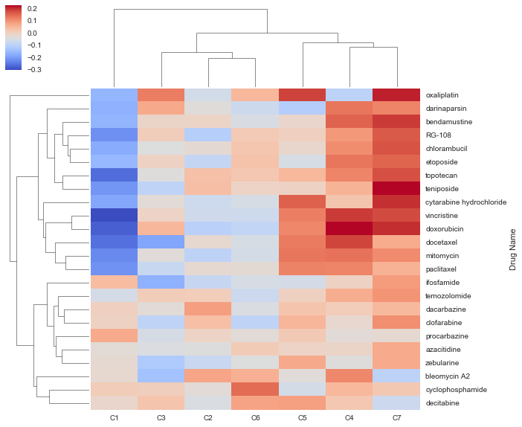
Drug Resistance by Component
(Spearman’s correlation coefficient 𝝆)
Coag./ Comp./ Oxid.
Phos.
Coag./
Comp./
EMT/
P53 path.
MYC/ Cell cycle
Cell cycle
MYC/ Oxid. Phos.
MYC/ Oxid. Phos.
EMT
Drug activity
Cross-linkers
DNA alkylators
Inducers of DNA damage
Inhibitors of topoisomerase I/II
Inhibitors of microtubule assembly
Inhibitors of DNA methyltransferase

Slide 27
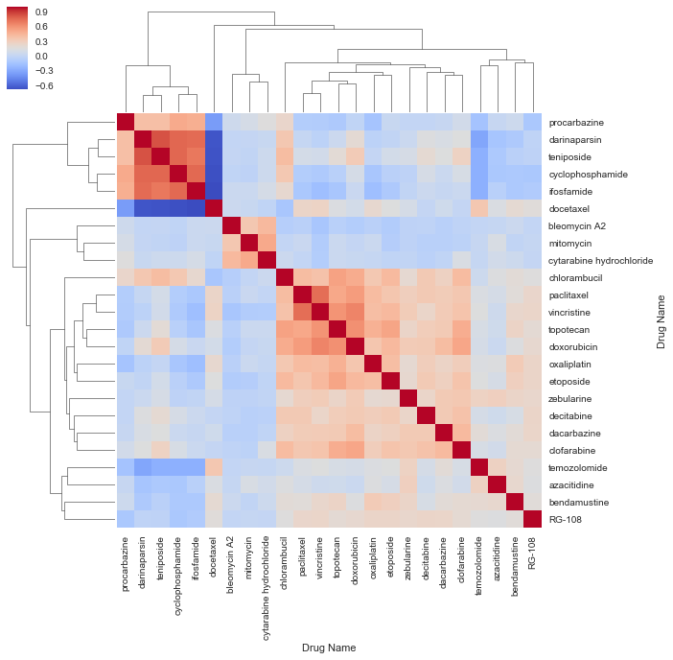
Drug Resistance by Drug Resistance
(Spearman’s correlation coefficient 𝝆)
Drug activity
Cross-linkers
DNA alkylators
Inducers of DNA damage
Inhibitors of topoisomerase I/II
Inhibitors of microtubule assembly
Inhibitors of DNA methyltransferase

Slide 28
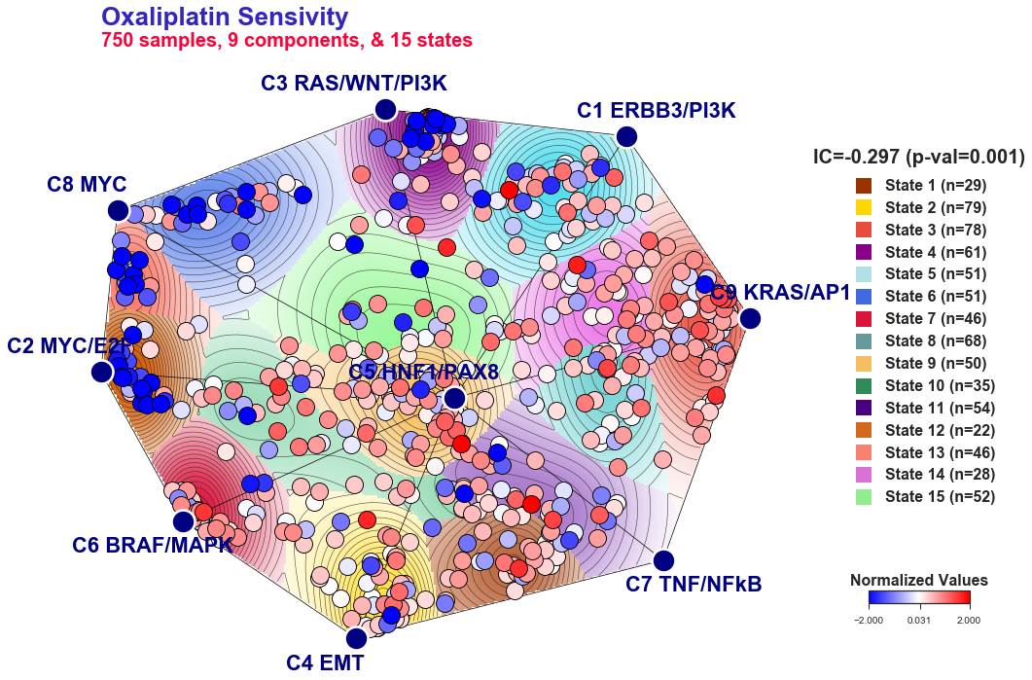
Was using the platinum-phenotype derived gene list advantageous?
Plati-Res Map made with genes related to KRAS signature

Slide 29
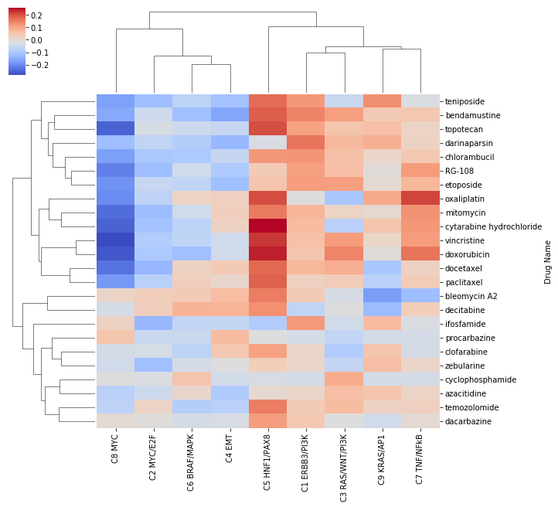
Plati-Res Map made with genes related to KRAS signature
Drug Resistance by Component
(Spearman’s correlation coefficient 𝝆)
MYC
MYC
/E2F
BRAF / MAPK
EMT
HNF1 /PAX8
ERBB3
/PI3K
RAS /WNT /PI3K
KRAS /AP1
TNF
/NFkB
Sensitive components more dispersed
Different component annotations by the inclusion of different genes may give more insight to certain resistant/sensitive components

